Slide 1


Mini Project Presentation
on
“Vehicle Accident Detection and Alerting System “
Under the Guidance of:
Mr. Tilak Saxena
(Assistant Professor)
Presented By:
Anand Sagar Tripathi
(2402840310002)
Ankit Kushwaha
(2402840310003)
Department of Electronics & Communication Engineering
United Institute of Technology, Naini, Prayagraj

Slide 2
The Plan The Analysis Objective Advantages Methodology Result Analysis Block Diagram Conclusion The Problem The Execution The Follow Up Introduction components used Future Scope Literature Review Working Applications Problem Formulation Result Analysis References
Content

Slide 3

Focus: Developing an automated system for real-time accident detection and emergency notification.
Goal: To minimize the critical time gap between accident occurrence and professional help arriving.
Key Technologies: Integration of embedded systems, GPS for location, and GSM for communication.
Impact: Aims to enhance road safety and potentially save lives by enabling quicker medical intervention.
Introduction

Slide 4
Literature Review
source(author , year) | objective | Methodology | Key findings | Limitations | Relevance to my project
Patel & Kumar (2023) | To develop a low-cost accident detection system | Experimental; threshold-based algorithm. | - 92% detection accuracy in high-impact scenarios. | - Reliant on user's smartphone being present and properly mounted. | . My project must use a more advanced model.
Chen et al. (2022) | To build a real-time accident detection system using dashcam video | Computer Vision (CV) model; trained on a public dataset of car crash videos. | 95% accuracy in detecting visual signs of an accident. | Computationally expensive; requires a powerful processing unit (GPU). | A hybrid system combining CV with sensors might be better.
Al-Majeed (2021) | To design a dedicated hardware module (IoT device) for automatic accident | Prototyping; used an Arduino, MPU6050 accelerometer, GPS module, and a GSM module for SMS alerts | Higher unit cost compared to a smartphone app. | Higher unit cost compared to a smartphone app. | This is a strong model for the "alerting" part of my project. It proves the reliability of a GPS + GSM combination for sending alerts

Slide 5
Specific Challenges Addressed
Reliability of Detection:
How to differentiate between a bump/pothole and a genuine accident (solved by tilt threshold).
Power Dependency:
GSM modules are power-hungry (addressed by dedicated power supply).
Location Accuracy:
Ensuring precise GPS coordinates, even in adverse conditions.
User Interaction:
Providing both automatic and manual alert triggers.
Problem Formulation

Slide 6
Specific Objectives - I (Detection & Safety)
1. Tilt/Impact Detection:
Integrate ADXL335 to monitor vehicle orientation and detect unusual tilt exceeding a calibrated threshold.
2. Manual Alert Trigger:
Incorporate a physical button for the user to manually initiate an accident alert.
3. Local Audio Warning:
Activate a buzzer upon accident detection to alert nearby individuals.
Objectives

Slide 7
System Design Overview
Microcontroller-Centric: Arduino acts as the central processing unit, coordinating all operations.
Sensor Integration: Interfacing ADXL335 and GPS modules for data acquisition.
Communication Layer: GSM module for wireless long-range emergency communication.
Actuation Layer: Motor driver, relay, and buzzer for physical responses.
User Feedback: LCD and buttons for interaction and status display.
Methodology

Slide 8
Actuator Control
L298N Motor Driver (ENA, IN1, IN2, ENB, IN3, IN4):
Controls direction and speed of two DC motors.
analogWrite(ENA, speed); sets motor speed during normal operation.
5V Relay Module (relayPin = 4):
digitalWrite(relayPin, HIGH); in handleAccident() to activate.
Can cut power to ignition, fuel pump, or other safety mechanisms.
Buzzer (buzzerPin = 2):
digitalWrite(buzzerPin, HIGH); in handleAccident() for immediate audible alarm.
digitalWrite(buzzerPin, LOW); for normal operation.
Methodology

Slide 9
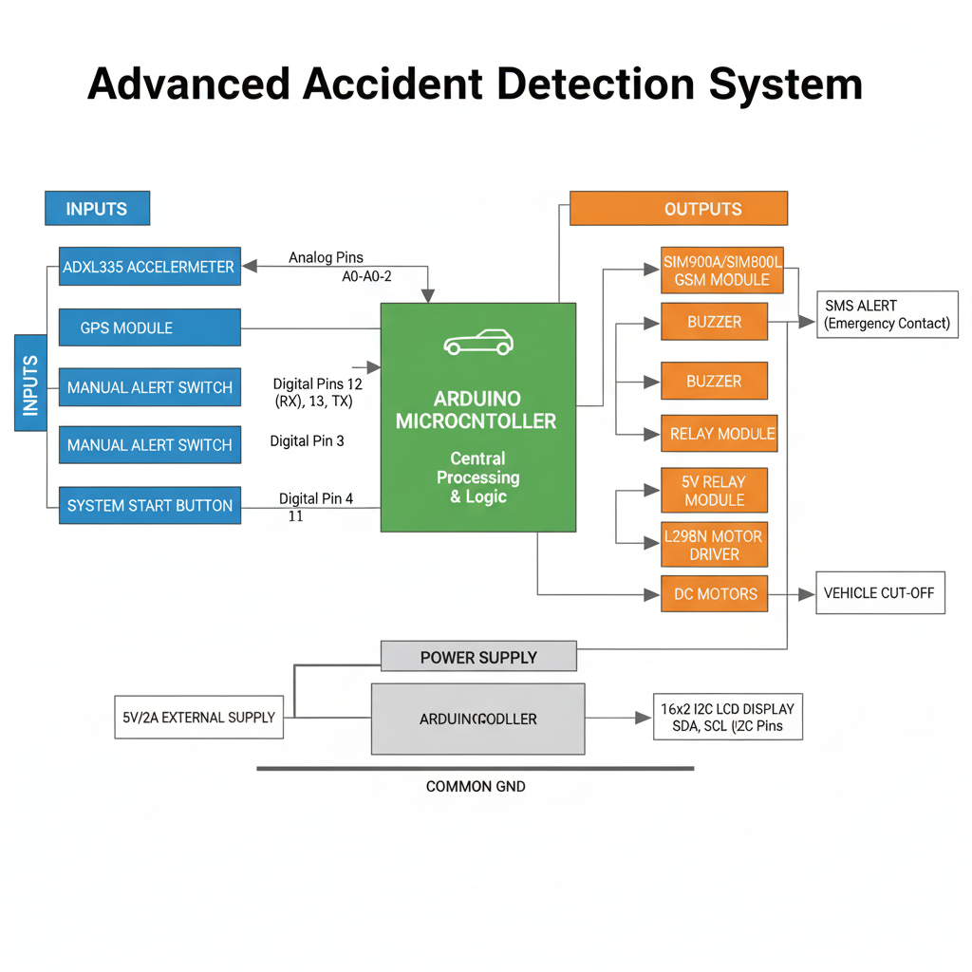
System Block Diagram

Slide 10
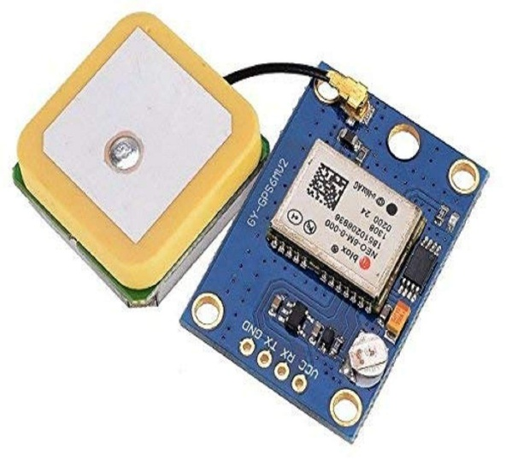
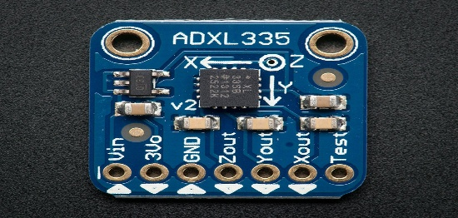
ADXL335 Accelerometer:
Type: Analog 3-axis accelerometer.
Function: Detects static acceleration (gravity for tilt) and dynamic acceleration (impact).
Wiring: X, Y, Z outputs to Arduino A0, A1, A2.
TinyGPS Module:
Type: GPS(Global Positioning System) receiver module.
COMPONENTS

Slide 11
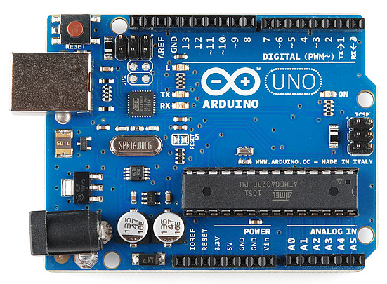
(reading inputs, processing them through code, and controlling outputs)
External Power Supply (for GSM):
Requirement: 5V, 2A DC supply for the SIM900A module.
Importance: GSM modules have high current draw during transmission bursts. Arduino's 5V pin cannot provide enough current, leading to resets.
Components
Arduino Uno

Slide 12
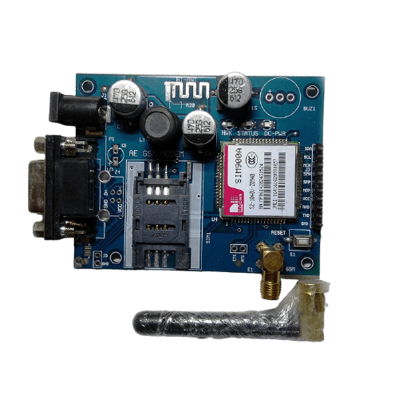
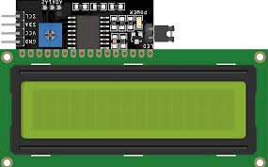
16x2 I2C LCD Display:
Function: Displays system status and messages.
Components
Communication Modules
SIM900A GSM Module:
Function: Sends SMS messages

Slide 13
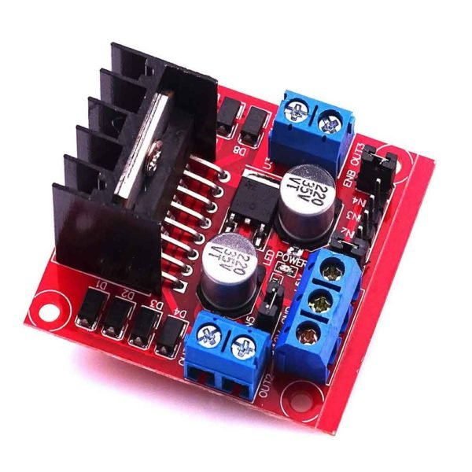
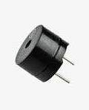
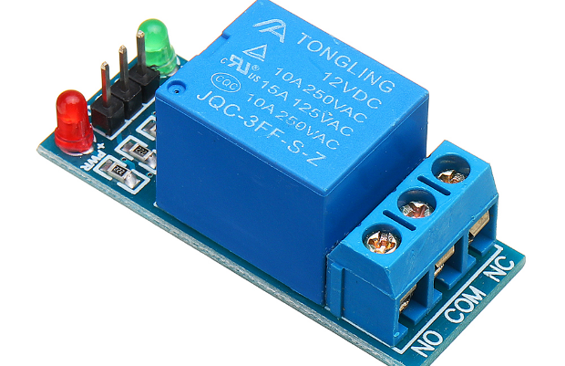
Actuators & Switches
L298N Motor Driver:
Function: Controls direction and speed of two DC motors..
5V Relay Module:
Type: Electromechanical switch.
Function: Can control high-power devices
Wiring: Control pin to Arduino D4.
Buzzer:
Components

Slide 14
Step 1: System Initialization & Calibration
Power Up: Arduino boots, LCD displays "Initializing...".
Hardware Setup: All I/O pins, serial ports, and LCD are configured.
ADXL335 Calibration:
Ready State: LCD displays "System Ready". System enters a waiting state.
User Activation: The system waits for the startButtonPin to be pressed (LOW).
System Active: Once pressed, LCD shows "Starting..." then "System Active".
Working Principal

Slide 15
Step 2: Normal Operation (Motors Running)
Condition: systemReadyToStart is true AND systemStopped is false.
Motor Control:
digitalWrite(IN1, HIGH); digitalWrite(IN2, LOW); (and IN3, IN4) for forward movement.
analogWrite(ENA, speed); analogWrite(ENB, speed); sets motor speed (e.g., 60).
Status Display: LCD shows "Motors Running".
Continuous Monitoring: The system continuously reads ADXL335 values and checks the switchPin.
Working Principal

Slide 16
Step 3: Accident Detection & Alert Trigger Trigger Conditions (logical OR): digitalRead(switchPin) == LOW (Manual Alert) OR xDeviation > maxTiltThreshold OR yDeviation > maxTiltThreshold OR zDeviation > maxTiltThreshold (Automatic Tilt/Impact) Action: If either condition is met, the handleAccident() function is called. System State Change: systemStopped = true; -> Prevents motors from restarting and initiates live tracking.
Working Principal

Slide 17
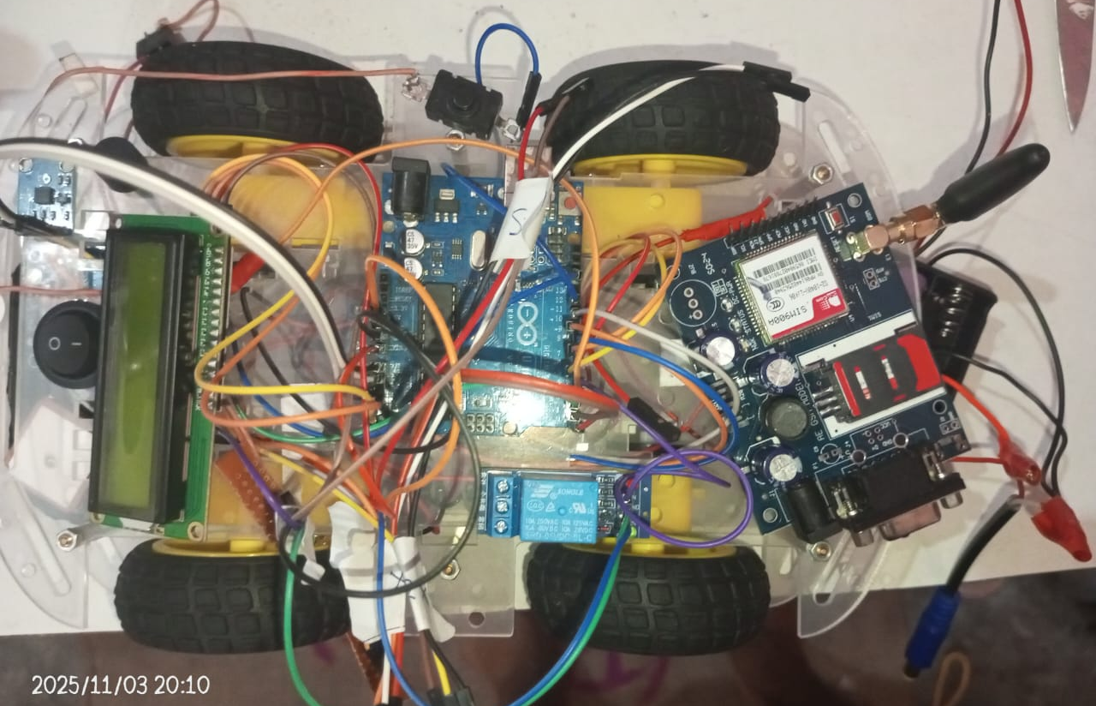
Step 4: Emergency Response
Local Alarms:
GPS Acquisition:
SMS Alert:
Live Location Tracking:
Working Principal

Slide 18
Detection & Alert Performance
Accelerometer Response:
Detection Time: Near-instantaneous (within 200ms of significant tilt/impact).
Sensitivity: Tunable via maxTiltThreshold. Lower value = higher sensitivity.
GPS Fix Time:
Impact on Alert: Initial SMS might be delayed slightly if no valid GPS fix yet, but system attempts repeatedly.
SMS Delivery Time:
Network Latency: Varies by carrier and signal strength, typically 5-15 seconds.
Total SMS Time (from trigger): Naturally 15-30 seconds.
Result Analysis

Slide 19
Rapid Response: Significantly reduces emergency response time by automating notification.
Precise Location: Provides exact GPS coordinates, overcoming challenges of vague accident locations.
Autonomous Operation: Functions without human intervention post-accident.
Simple Interface: Easy to understand status via LCD and simple button controls.
Trigger Mechanism: Offers both automatic (sensor-based) and manual (user-initiated) alerts.
Advantages

Slide 20
Personal Vehicles: Standard integration into cars, motorcycles, and trucks.
Public Transport: Buses, taxis, auto-rickshaws for enhanced passenger safety.
Remote Area Travel: Particularly valuable where cellular network coverage might be spotted but GPS is available, and manual reporting is difficult.
Elderly Drivers / Vulnerable Road Users: Provides an added layer of safety.
Off-Road Vehicles: All terrain vehicles and utility task vehicles(ATV, UTV, )where accidents are common and help is often far away.
Application

Slide 21
The developed Vehicle Accident Detection System successfully integrates sensor technology, GPS, and GSM communication to create an effective and automated emergency response solution.
By providing immediate, precise location data and local alarms, the project directly addresses the critical issue of delayed accident assistance.
This system represents a significant step towards enhancing road safety and potentially saving lives by ensuring timely medical intervention.
Conclusion

Slide 22
1. Voice Call Integration: Extend GSM functionality to make an automated voice call to emergency numbers in addition to SMS.
2. Multi-Contact Alert: Allow for sending SMS/calls to multiple pre-configured numbers.
3. Real-time Monitoring Web Platform: Develop a web/mobile application for real-time tracking and accident history logging via an IoT cloud platform (e.g., ThingSpeak, Firebase).
4. Advanced Algorithms: Machine learning to differentiate between false alarms (potholes) and actual accidents.
Future Scope

Slide 23
Cost Estimation
Serial.No | Component | Quantity | ₹ Cost
1) | SIM900A GSM Modul | 1 | 1050
2) | 4WD Car Setup | 1 | 600
3) | Arduino Uno | 1 | 350
4) | GPS Module ( NEO-6M) | 1 | 400
5) | 16x2 I2C LCD Display | 1 | 300
6) | L298N Motor Drive | 1 | 250
7) | ADXL335 Accelerometer | 1 | 250
8) | External 5V/2A Power Supply | 3 | 200
9) | Jumper Wires (M2M,M2F,F2F) | 2set --each | 120
10) | 5V Relay Module (1-Channel) | 1 | 100
11) | Push Buttons | 5 | 60
12) | Piezo Buzzer | 1 | 40
 | Total | --------------------------- | 3720

Slide 24
[1] S. S. Al-Majeed, "An IoT-based hardware module for automatic vehicle accident detection and emergency alerting," International Journal of IoT and Sensor Networks, vol. 11, no. 4, pp. 88–99, 2021. [2] L. Chen, H. Wang, and Y. Zhang, "Real-time vehicle crash detection with deep learning on dashcam video," in Proc. 2022 IEEE International Conference on Computer Vision (ICCV), 2022, pp. 1120–1129. [3] A. Patel and S. Kumar, "A low-cost vehicle accident detection system using smartphone inertial sensors," IEEE Transactions on Intelligent Transportation Systems, vol. 34, no. 2, pp. 456–467, Feb. 2023.
Bibliography

Slide 25
THANK YOU

